Slide 1

Employee Attrition Prediction
Capstone Project
Group 05:
K RAMAKRISHNAN
VIJAY KUMAR
KIRTI RANI
NIMANSHA MALIK
ABHISHEK SHUKLA

Slide 2
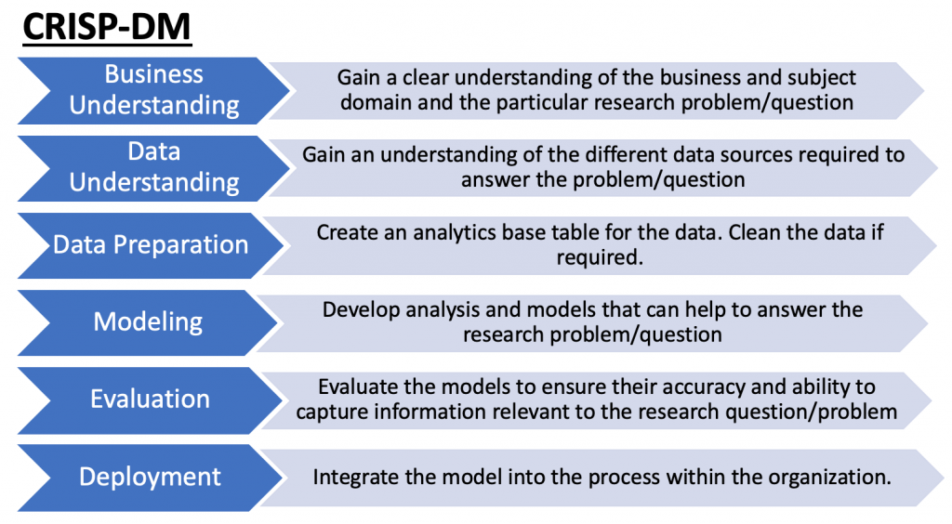
Agenda
1
Business Understanding
2
Data Understanding
3
Data Preparation
4
Modeling
5
Evaluation
6
Deployment
7
Conclusion
8
End
Notes:
Agenda slide

Slide 3




Business Understanding
Data
Understanding
Data Preparation
Modeling
Evaluation
Deployment
Conclusion
Problem statement:
Employee are the pillars of organization and workforce retention is one of the key factor in measuring the organizational growth. But swelling attrition levels across the businesses are strait-jacketing the distraught HR practitioner’s ability to come out with good retention strategies. Employee attrition must be decreased for a firm as it increases the high training cost and the crucial business time of an organisation.
Importance:
Organisation success hinges much on the retention of employees
Frequent attrition impacts the morale of the organization
Hiring new employees is more expensive than retaining existing ones
People emerge key competitive differentiators
Losing knowledgeable and trained employees can cause serious damage to the company’s progress and performance in the market.
Notes:
1.

Slide 4

Business Understanding
Data
Understanding
Data Preparation
Modeling
Evaluation
Deployment
Conclusion
Project Charter
Approach
After proving its mettle in sales and marketing, artificial intelligence is also becoming central to employee-related decisions within HR management.
Therefore, the objective is to build a model to predict employee attrition which could help human resource department strategize hiring and retention process.
Value Proposition
Less attrition and better employee retention.
Engaged employees
Expected Deliverables
Build a predictive model with good accuracy to predict if an employee is likely to leave or not.
Recommendations for better employee retention

Slide 5
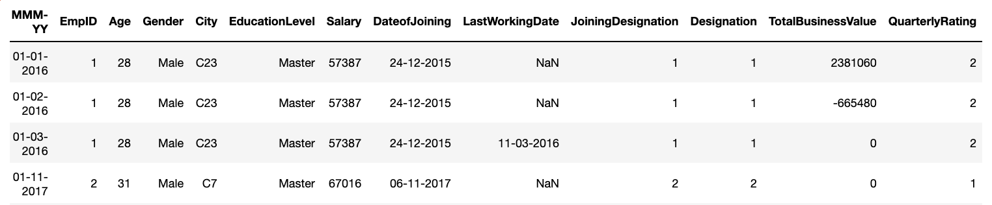
Business Understanding
Data Understanding
Data Preparation
Modeling
Evaluation
Deployment
Conclusion
Features / Attributes
MMMM - YY
Reporting Date (Monthly) – When the employee data is updated
Emp_ID
A unique ID that helps to identify each employee distinctly
Age
Age of the employee on the Reporting Date
Gender
Gender of the Employee
City
City code of the Employee
Education Level
Education Level of the Employee : Bachelor / Master / College
Salary
Salary of the Employee on the Reporting Date
Dateof joining
The date when the Employee joined the Organization
LastWorkingDate
Last date of working for the employee –
Null for the employees still working in the Organization
Last date of working for the employees who left the Organization
Joining Designation
Designation at which the Employee was hired
Designation
Designation of the Employee on the Reporting Date
TotalBusinessValue
Total business value acquired by the Employee in a month –
Positive value corresponds to successful sold of insurance policy
Negative value corresponds to cancellation / refund of the sold insurance policy
Zero value corresponds to the case when the Employee couldn’t sell any insurance policy in the given month
Quarterly Rating
Quarterly rating of the Employee as evaluated on the basis of Employee’s performance in the given quarter
Possible values: 1, 2, 3, 4
Higher value indicates better performance and better rating

Slide 6
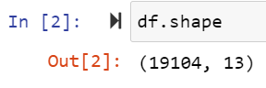
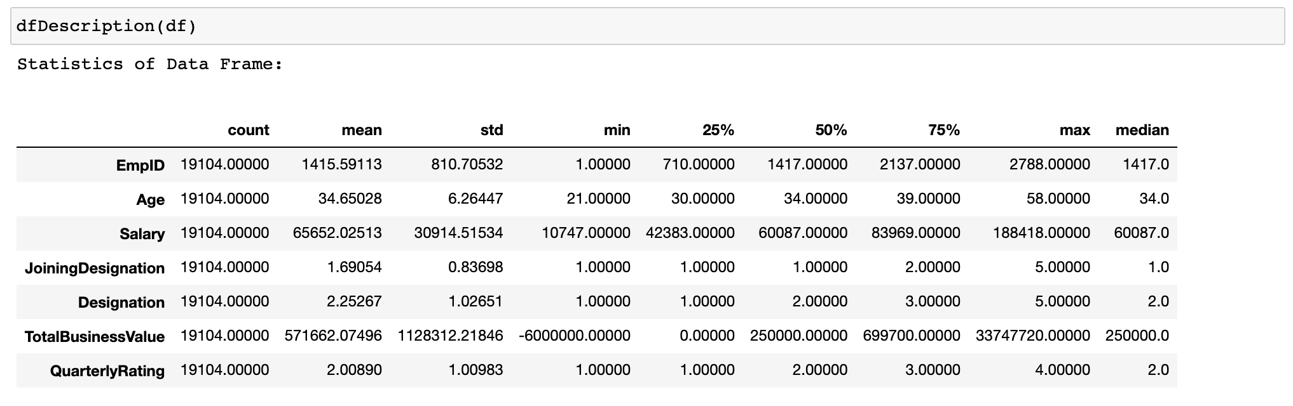
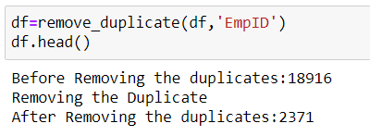
Business Understanding
Data Understanding
Data Preparation
Modeling
Evaluation
Deployment
Conclusion
About the Dataset
Given data set “train.csv” has 19104 records
Max age: 58, Min :21
Huge std deviation
Max : 5, Min :1
Huge std deviation
Max : 4, Min :1
Out of the 19104 records the data has 16733 duplicate entries when filtered with EMP_ID
After filtering by employee ID we have data of 2371 Employees for analysis
file:///Users/nimanshamalik/Documents/WILP_AIML/C7_CapstoneProject/rpt.html

Slide 7
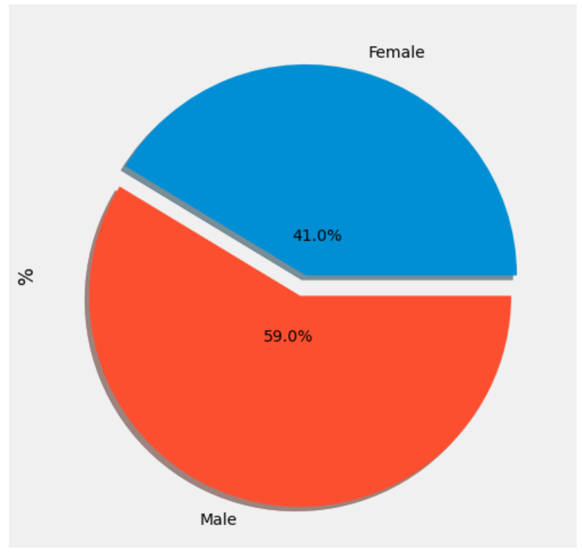
Business Understanding
Data Understanding
Data Preparation
Modeling
Evaluation
Deployment
Conclusion
About the Dataset
Data set has 2016 and 2017 employee data ( intermediate data set)
We could also see designation and salary has changed only for 43 employees in 1 year data set given for employees (1 appraisal cycle data)
Quarterly rating is available for each employee (maximum of 8 quarterly rating for employee who is in system for 2016 and 2017 full year)
Emp ID is from 1 to 2788, but the data available only for 2371 employees ( 417 employees have left before 2016)
Out of total Employees , the percentage of Female Employees is 41% and that of Male Employees is 59%

Slide 8
Business Understanding
Data Understanding
Data Preparation
Modeling
Evaluation
Deployment
Conclusion
Data Quality Issues
Last Date of Working vs Date of Joining
Ideally the Last date of Working for an Employee should be later than the Date of Joining
Found around 70 instances where Date of Joining is later than Last Date of Working
How to deal?
Assumption : The 70 cases corresponds to the Employees who have re joined the organisation after resigning
Joining Designation vs Latest Designation
Ideally, we know that employees may get a 0 or 1 promotion per year
In the given that dataset, there are 44 cases where employees have got more than 1 promotion per year
A maximum of 50 promotions per year is observed
Notes:
Nimansha - till slide 8

Slide 9
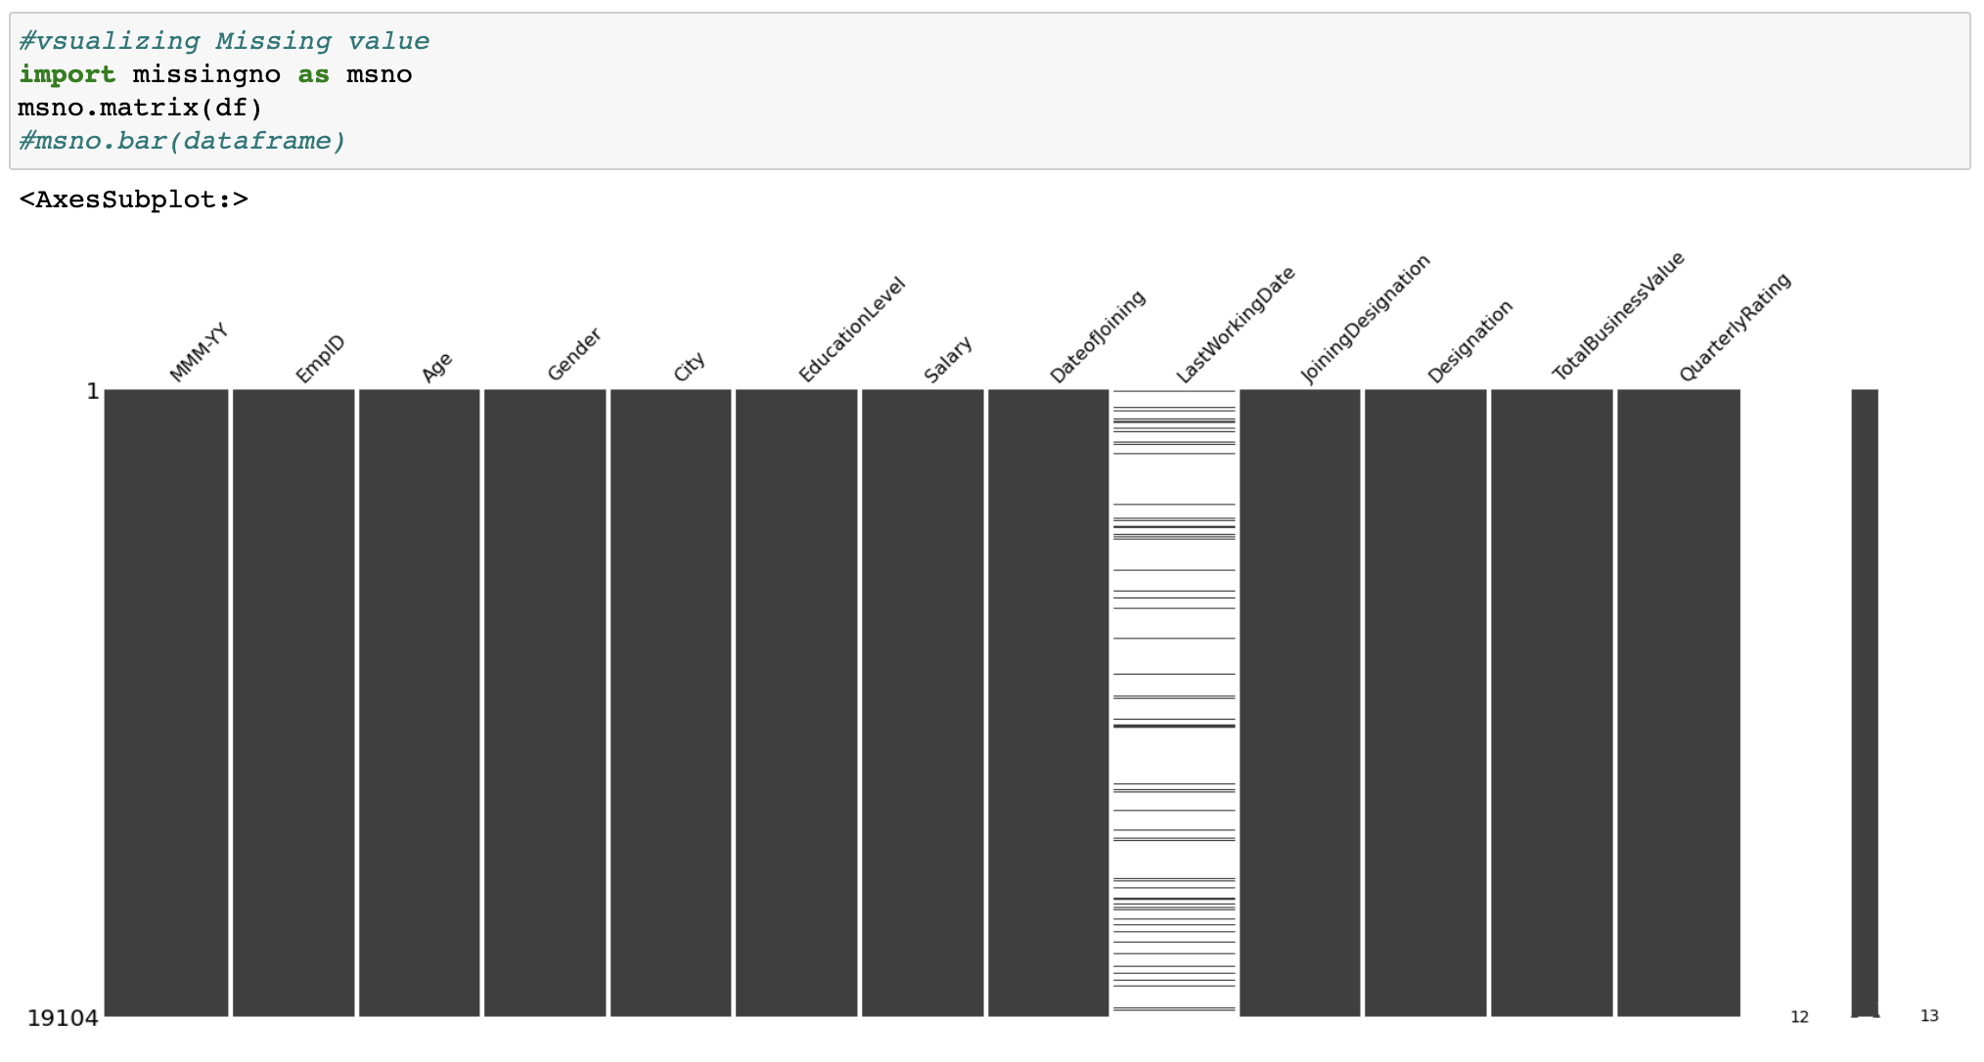
Business Understanding
Data Understanding
Data Preparation
Modeling
Evaluation
Deployment
Conclusion
Missing Values in the Dataset
LastWorkingDate is the only column that contains missing value in the dataset
The Missing values here corresponds to employees not resigning
Notes:
2.

Slide 10
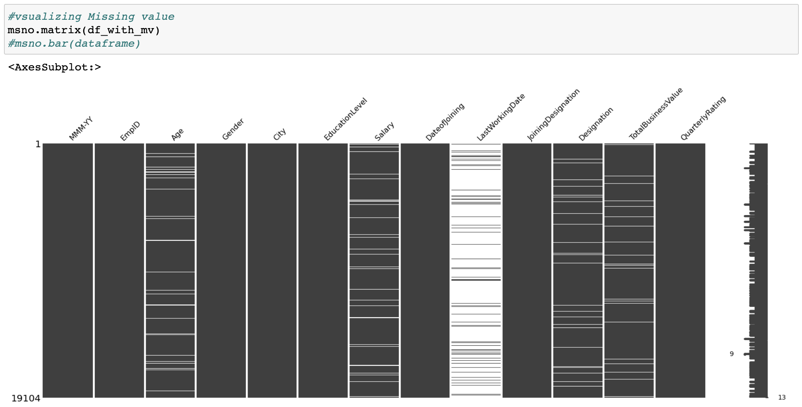
Business Understanding
Data Understanding
Data Preparation
Modeling
Evaluation
Deployment
Conclusion
Missing Values in the Dataset
Induced 5% Missing values in columns Age, Salary, Designation, TotalBusinessValue for implementing Missing value imputation in the copy dataframe
Used MICE Imputation Technique

Slide 11
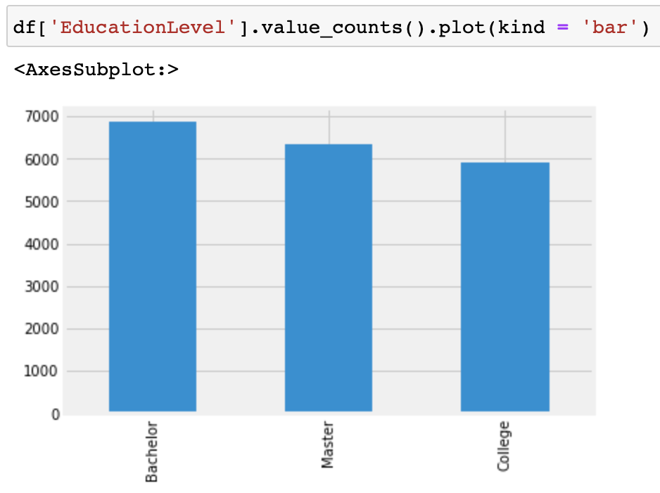
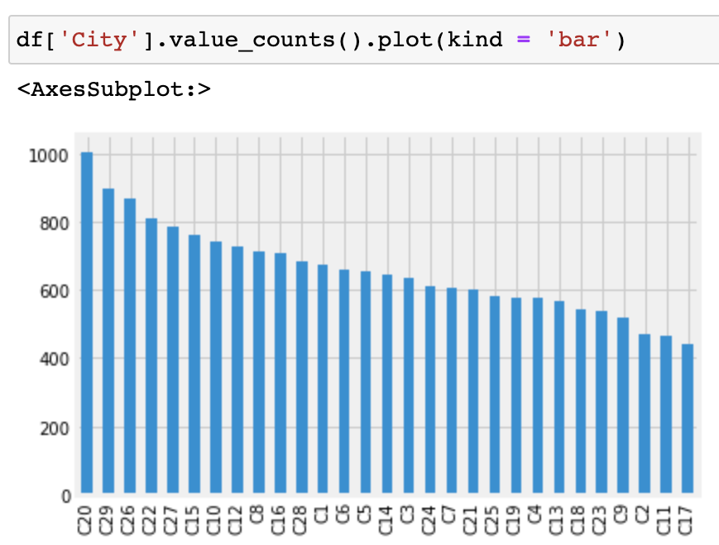
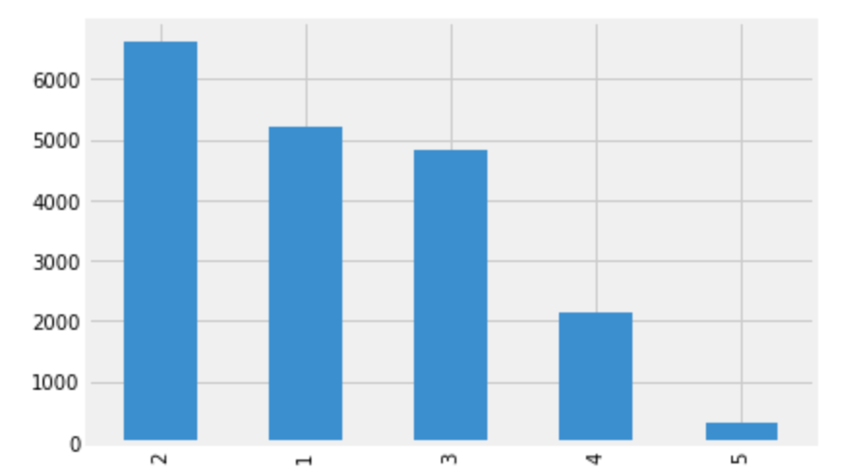
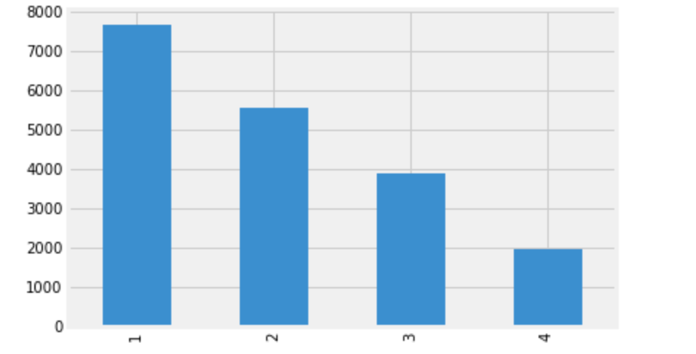
Business Understanding
Data Understanding
Data Preparation
Modeling
Evaluation
Deployment
Conclusion
Value Counts Plot
Employees come from 27 cities
Education level has 3 categories.
Education Level
City
Quarterly rating have 4 levels
Designations have 5 levels
Designation
Quarterly Rating

Slide 12
Business Understanding
Data Understanding
Data Preparation
Modeling
Evaluation
Deployment
Conclusion
Data Extraction
Resign (Target Variable) : Derived from the Last Working Date
Retention Years : Derived from features – Date of Joining, Last Working Date and Latest Reporting Date
Promotion : Derived from the difference in the Joining Designation and the Designation at the latest Reporting Date
Hike% : Derived from the salary changes across all the reporting dates corresponding to each Employee
For each employee it is possible to derive the change in designation and salary in 1 appraisal cycle by comparing 2016 and 2017 data ( around 12 months from date of joining)
Quarter : As quarterly rating is changing for each employee, we have created 8 quarters per employee ( 4 quarters in 2016 and 4 quarters in 2017) to understand the rating change trend.

Slide 13
Business Understanding
Data Understanding
Data Preparation
Modeling
Evaluation
Deployment
Conclusion
Data Extraction
Total business value also varies with each quarter. We have extracted the change in total business value for each employees to understand their sales performance.
New features added Salary_change, Designation_change, TotalBusinessValue_change, QuarterlyRating_change,
Year & Month columns are derived corresponding to the Date columns
BinnedSalary and BinnedAge columns are derived from binning the Salary and Age columns.

Slide 14
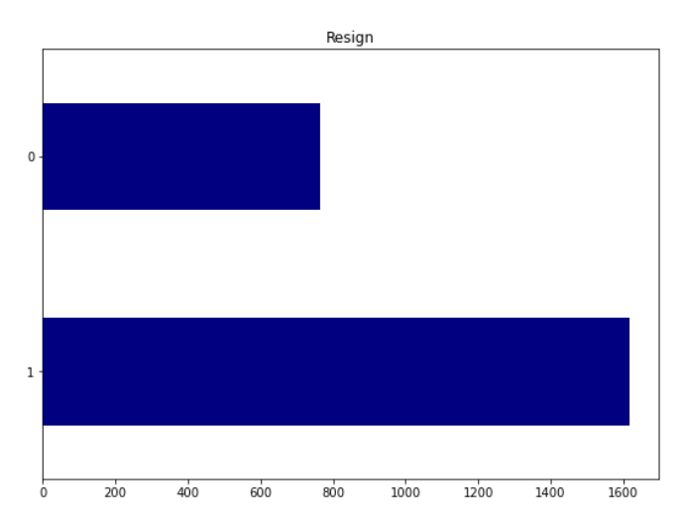
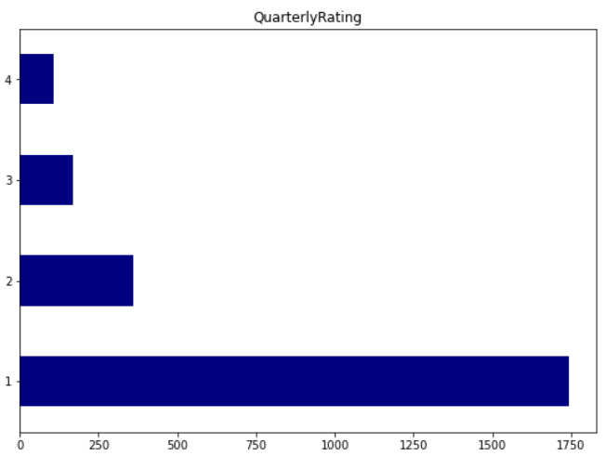
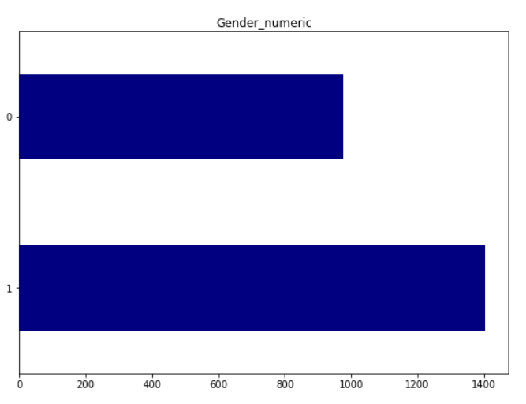
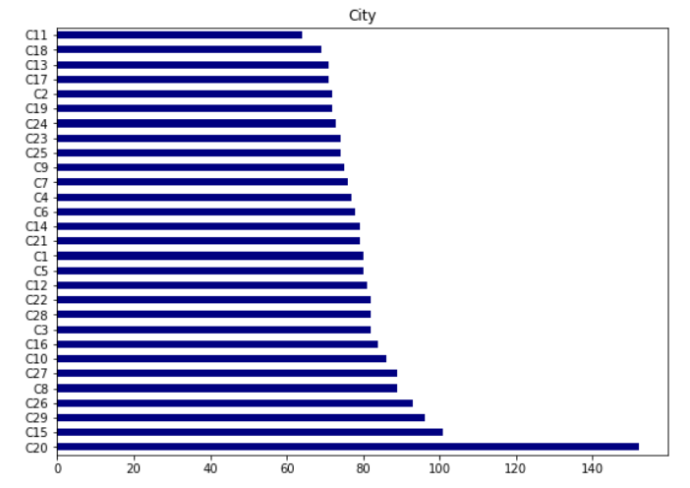
Business Understanding
Data Understanding
Data Preparation
Modeling
Evaluation
Deployment
Conclusion
Univariate analysis:
1616 have left and 765 are active : Attrition of 67%
Maximum employees are rated as 1
Employees are from different cities – fairly distributed
1404:977 (Male : Female)

Slide 15
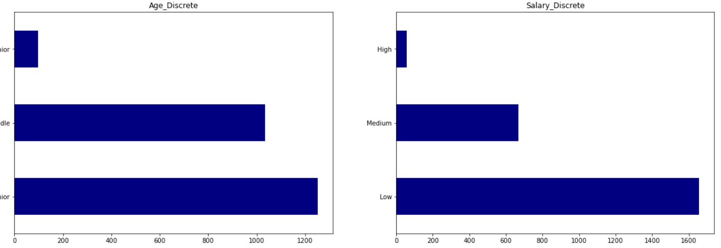
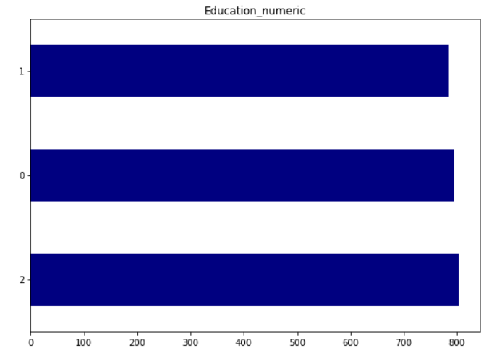
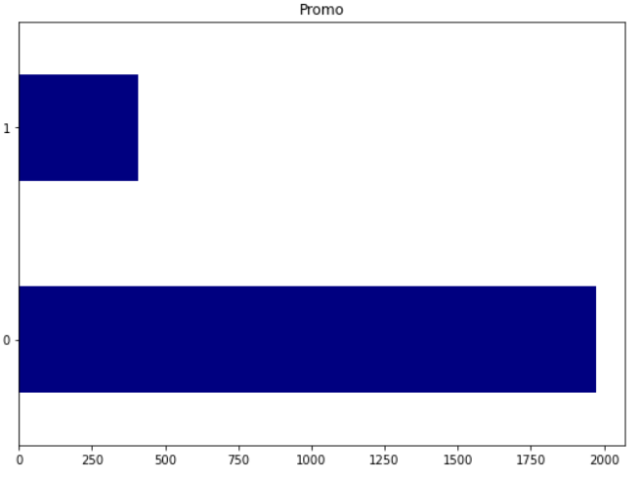
Business Understanding
Data Understanding
Data Preparation
Modeling
Evaluation
Deployment
Conclusion
Univariate analysis:
Maximum employees are junior category
Max employees are with low pay scale- consistent with Junior grades
Senior
Middle
Junior
Degree
There is no promotion for maximum no. of employees.
Education level is equally distributed.
College
Masters

Slide 16
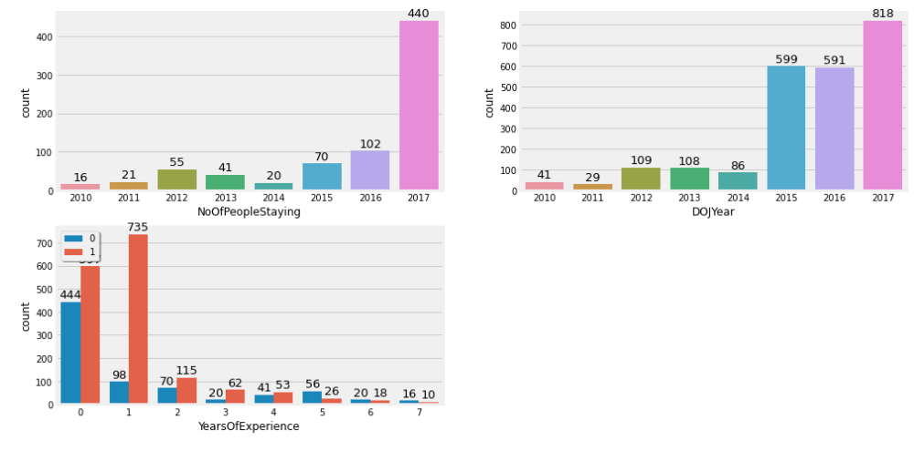
Business
Understanding
Data Understanding
Data Preparation
Modeling
Evaluation
Deployment
Conclusion
Uni-variate analysis:
By comparing DOJ and no. of people who are in the organisation, we could see huge attrition with people joined in 2015 to 2017.
This could be a typical scenario in IPO/Call Center organisation where the attrition is so high and employee hardly stay for 1 year.
Notes:
Ramki – till slide 16

Slide 17
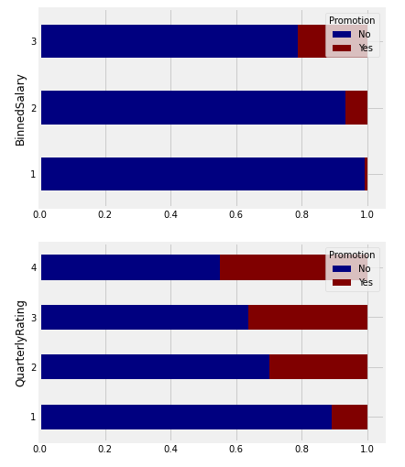
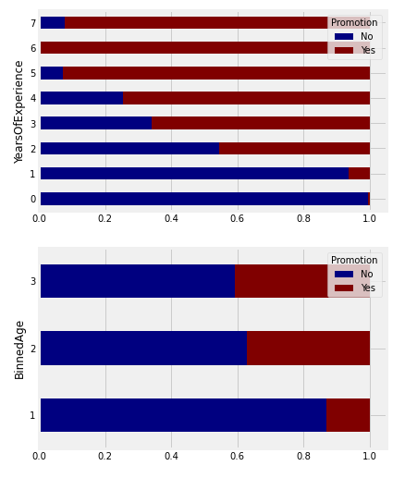
Business Understanding
Data Understanding
Data Preparation
Modeling
Evaluation
Deployment
Conclusion
Bi-variate analysis:
This is consistent with HR practices where promotion starts after 2 years.
High
Promotion and salary are related and consistent
Medium
Low
Senior
Promotion and rating are related and consistent
Promotion is mostly given for Middle and Senior.
Medium
Junior
Notes:
3.

Slide 18
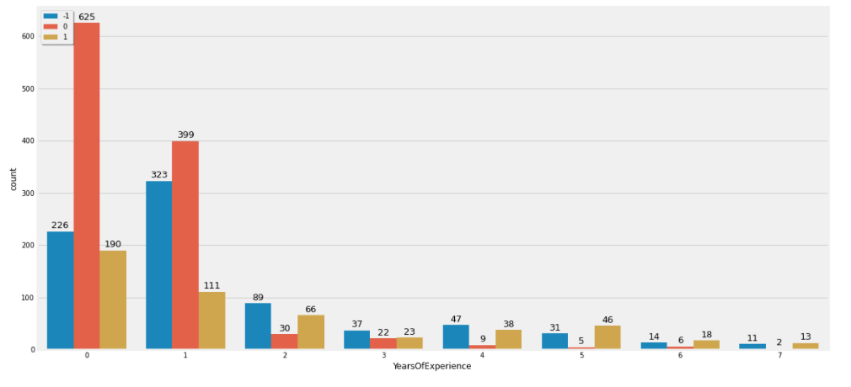
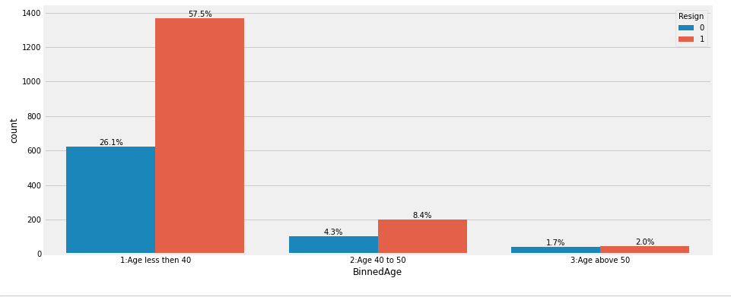
Business Understanding
Data Understanding
Data Preparation
Modeling
Evaluation
Deployment
Conclusion
Bi-variate analysis:
Business turnover Vs Years of experience
1-> positive sales
0-> no change in sales
-1-> negative sales
** more positive sales are seen with Senior people. ( however data for seniors are quite less)
Age Vs Resignation
Resignation is found in all age group. However attrition at junior level is quite high.

Slide 19
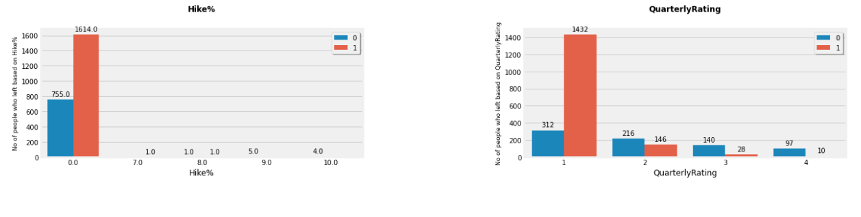
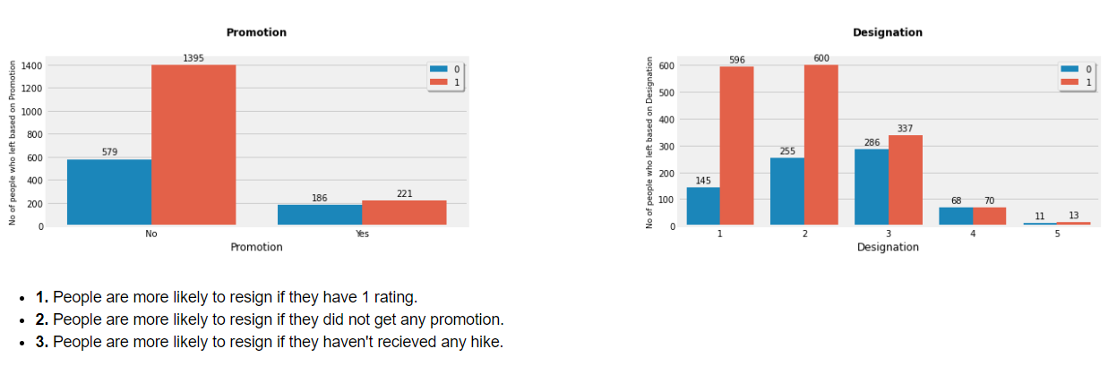
Business Understanding
Data Understanding
Data Preparation
Modeling
Evaluation
Deployment
Conclusion
Bi-variate analysis:
No hike given for most of the employees
This gives stronger reason for high attrition
Higher resignation for rating 1 & many are rated-1
0 (Blue) : Stayed
1 (Orange) : Resigned
Resignation is seen at all designations, however much higher for designation 1 &2

Slide 20
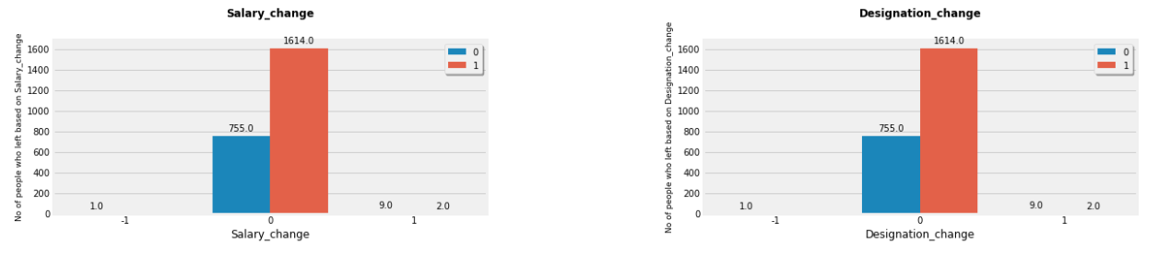
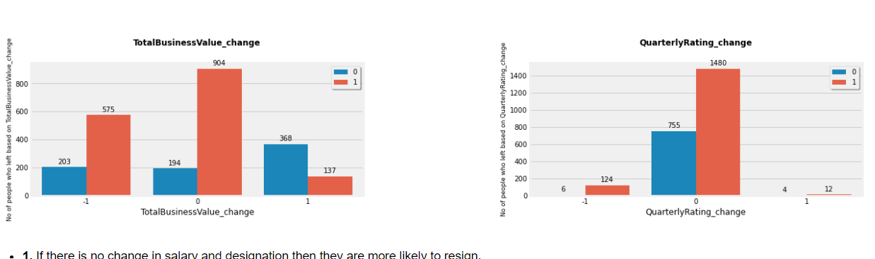
Business Understanding
Data Understanding
Data Preparation
Modeling
Evaluation
Deployment
Conclusion
Bi-variate analysis:
No Promotion, hence more attrition
No change in salary, hence more attrition
0 (Blue) : Stayed
1 (Orange) : Resigned
Decrease or no rating change pushes for more attrition
Resignation is seen at all sales turnover, however much higher for negative & zero sales

Slide 21
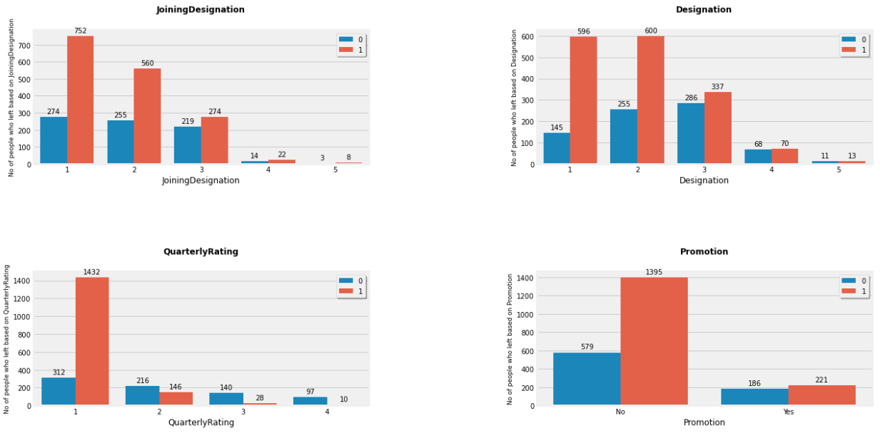
Business Understanding
Data Understanding
Data Preparation
Modeling
Evaluation
Deployment
Conclusion
Bi-variate analysis:
0 (Blue) : Stayed
1 (Orange) : Resigned

Slide 22
Business Understanding
Data Understanding
Data Preparation
Modeling
Evaluation
Deployment
Conclusion
Bi-variate analysis:
0 (Blue) : Stayed
1 (Orange) : Resigned

Slide 23
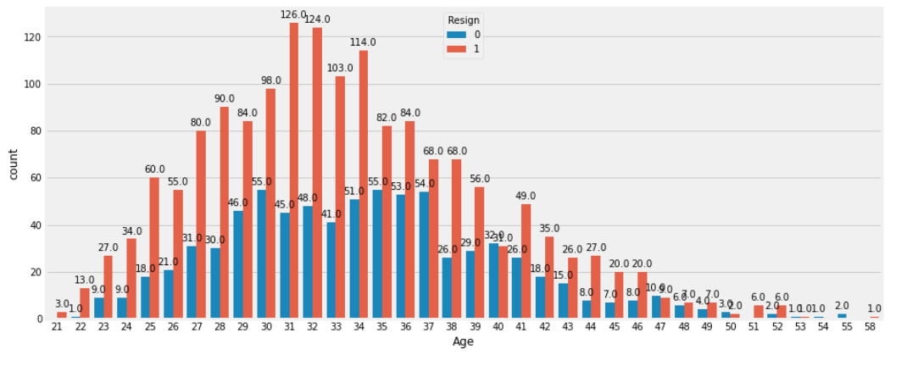
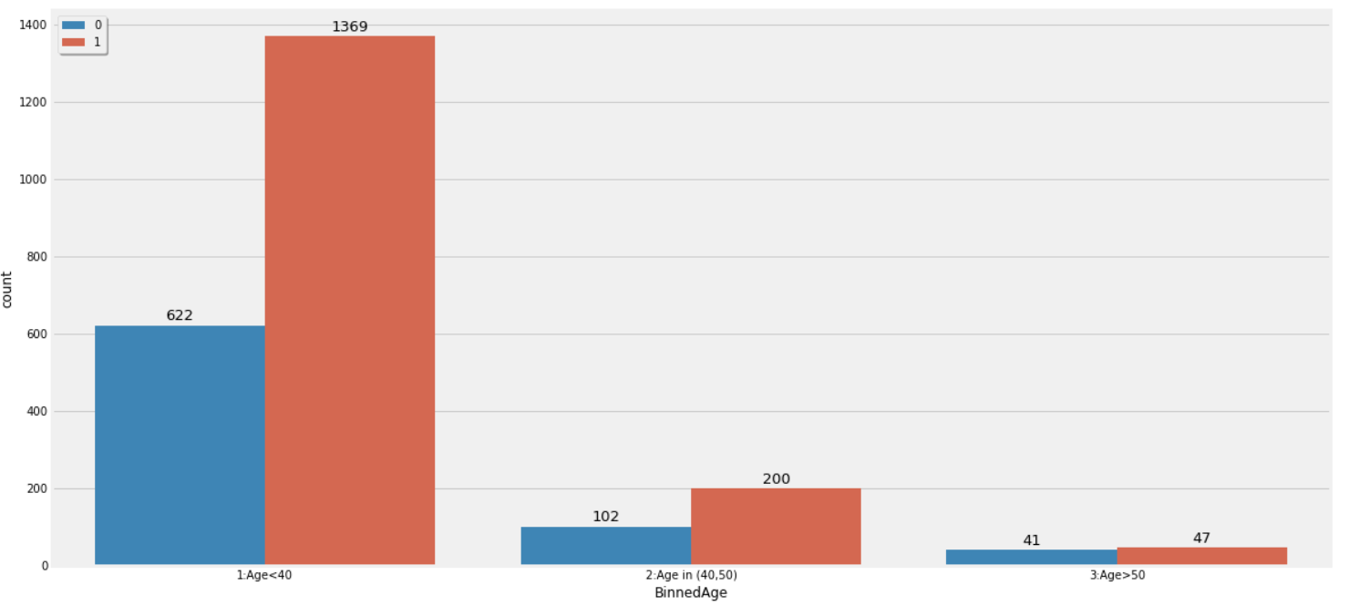
Business
Understanding
Data Understanding
Data Preparation
Modeling
Evaluation
Deployment
Conclusion
Bi-variate analysis:
0 (Blue) : Stayed
1 (Orange) : Resigned

Slide 24
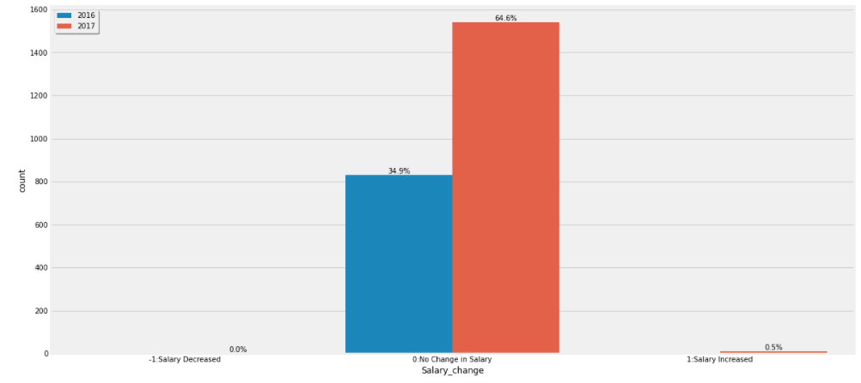
Business Understanding
Data Understanding
Data Preparation
Modeling
Evaluation
Deployment
Conclusion
Bi-variate analysis:

Slide 25
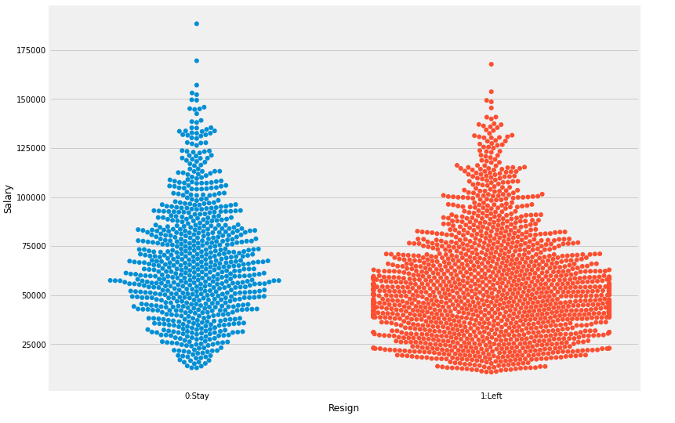
Business Understanding
Data Understanding
Data Preparation
Modeling
Evaluation
Deployment
Conclusion
Categorical plots ( Swarm plot)

Slide 26
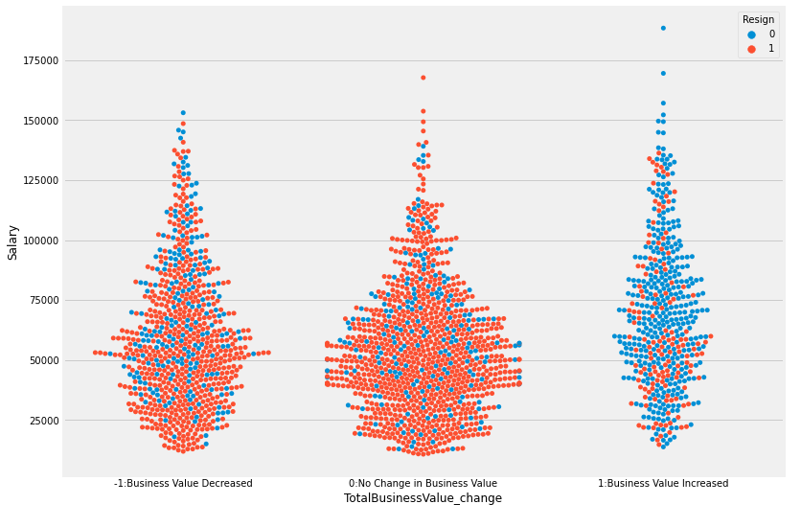
Business Understanding
Data Understanding
Data Preparation
Modeling
Evaluation
Deployment
Conclusion
Bi-Variate (Swarm plot):

Slide 27
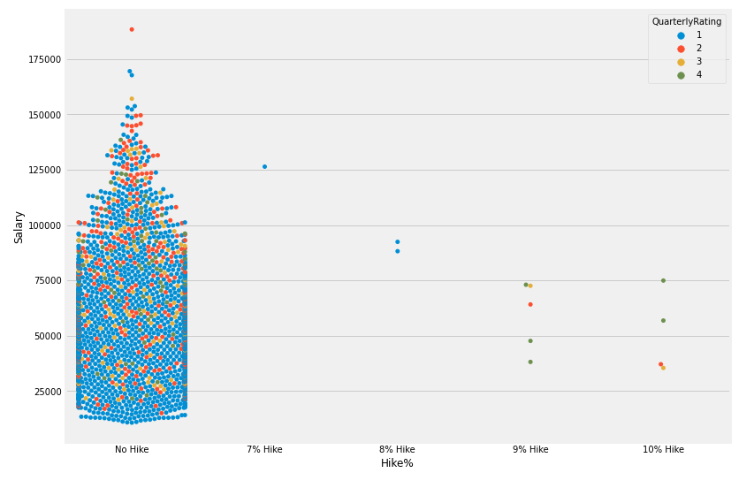
Business
Understanding
Data Understanding
Data Preparation
Modeling
Evaluation
Deployment
Conclusion
STRIP PLOT:
STRIP PLOT:

Slide 28
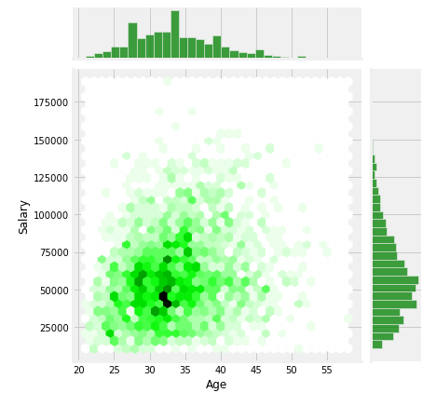
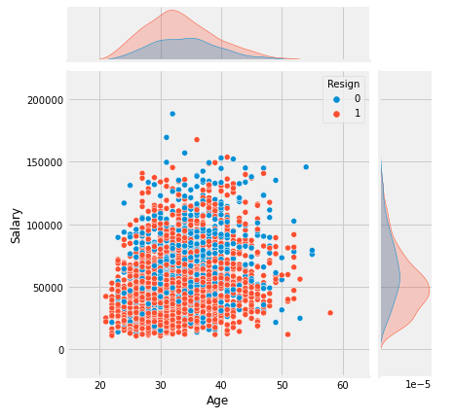
Business
Understanding
Data Understanding
Data Preparation
Modeling
Evaluation
Deployment
Conclusion
Numerical plots: (Joint plots)

Slide 29
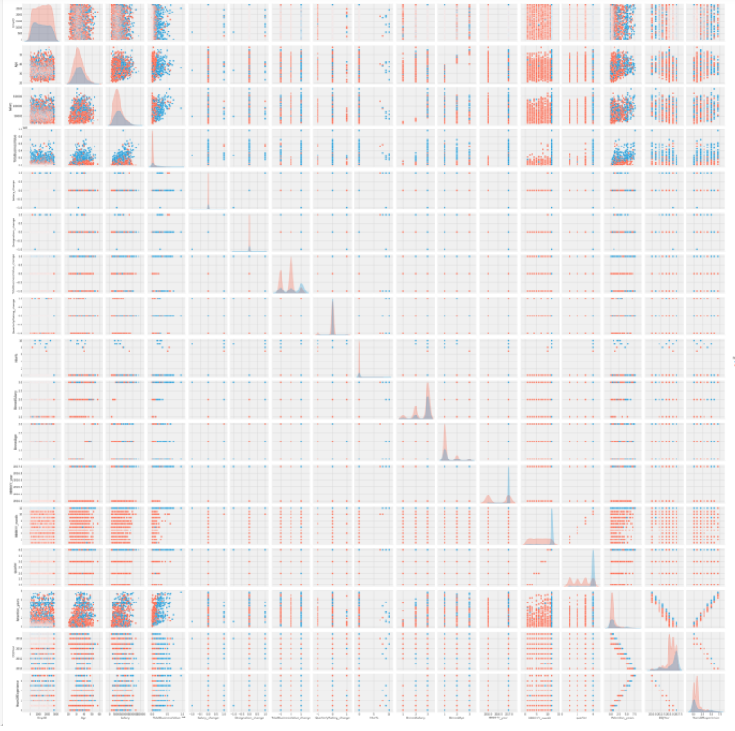
Business
Understanding
Data Understanding
Data Preparation
Modeling
Evaluation
Deployment
Conclusion
Pair plot for complete data set
██ Active
██ Inactive

Slide 30
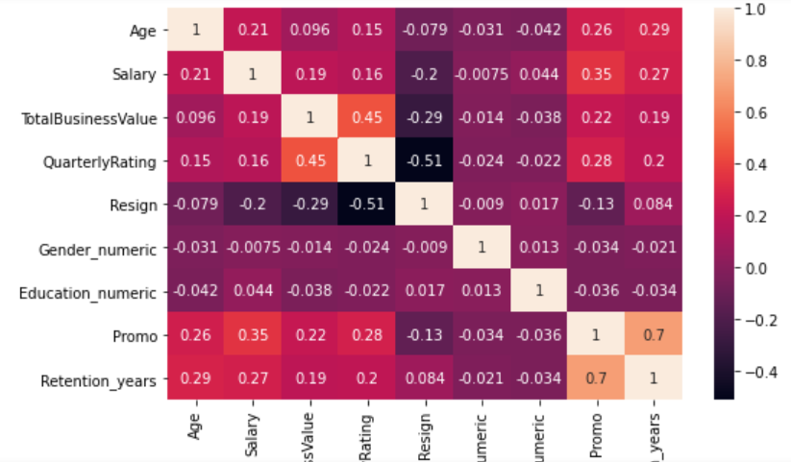
Business
Understanding
Data Understanding
Data Preparation
Modeling
Evaluation
Deployment
Conclusion
Heat map- Correlation of data
Salary, Business value, Rating and promotion has good correlation with attrition. Rating attribute has the highest correlation
Notes:
Abhishek & Kirti – till slide 30

Slide 31
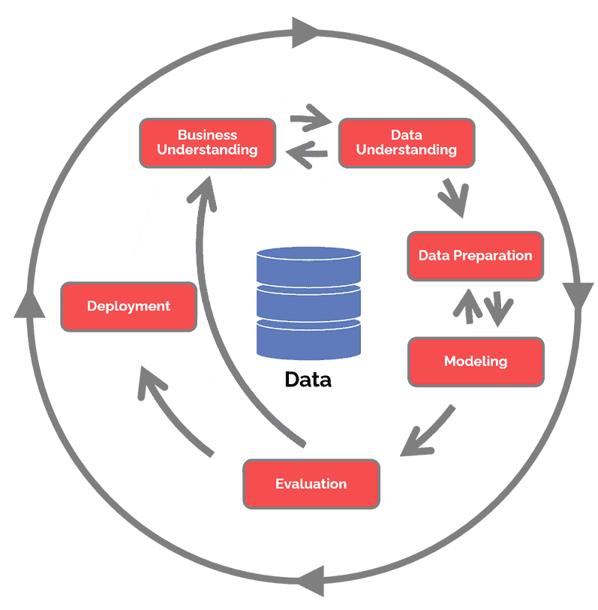
Employee attrition Prediction- Quick recap..
Scope
Methodology
Build a predictive model with good accuracy to predict if an employee is likely to leave or not
Recommendations for better employee retention
Value Proposition
Less attrition and better employee retention
Better employee engagement
Accomplishment
With the given data set of 19104 records we did a data clean up, removed duplication (16733) and meaningful data extraction for our analysis. ( 2371 employees and 13( original attributes) +10 derived attributes)
We did Uni variate and bi-variate analysis to understand the influence of each parameter w.r.t employee attrition.
Used several statistical plots & analysis to understand the distribution of data and extract 7 key influencing parameters
Tried Filter and Wrapper methods to extract key parameters which influenced the employee attrition.
Filter and Wrapper methods prove Quarterly rating (having highest information gain) is most influencing parameter & has strong relation with employee retention.
60 Predictive model ( 9 classification technique) tried in combination with different normalization, binning, hyper parameter tuning and recursive Feature Elimination with Cross validation.
We have proposed one best Predictive model by which we will be able to predict if the employee is likely to leave or not with 88% accuracy.
Model has been tested with 30 employee unknown data set and model was able to predict correctly for 29 out of 30 employees.
Basic deployment model using streamlit libraries has been created for ease of deployment and use for HR team.
Necessary recommendations are proposed ( based data analytics) to improve employee retention.
Notes:
1.

Slide 32
Business
Understanding
Data Understanding
Data Preparation
Modeling
Evaluation
Deployment
Conclusion
Summary of top observations from the visualization plots:
Given 2381 employee data 1616 employees have resigned and 765 are continuing in the same organisation. This is a huge attrition rate in the organisation which is at 67%. Also, the data set is imbalanced given 2 category of people who have left and who are staying back.
Data set has employees who have joined from 2010 to 2017, however the status of employees and several attributes like salary, promotion, Business value and quarterly ratings corresponds to the year 2016 to 2017. This is an intermediate data set for the year 2016-2017 covering 4 quarters of changes per employee.
84% of the employees are below 40 years of age with mean age at 34 years. Maximum group of people are in the lower age group.
Out of given dataset for 2381 employees, 2008 employees have joined the organisation only from 2015 to 2017 (84%). This is consistent with the Age group as we have maximum set of people in Junior age group and with lower salary.
Total business value generated by each employee has a strong correlation with quarterly rating, salary, grade change and resignation. Since Maximum group of people are less than 3 years of experience (joined from 2015 to 2017), Age and salary scale are also concentrated on the lower side.
Maximum employees are rated as ‘1’ (lowest performance rating) which can be related to huge attrition.
From Sworn plot, maximum employees who have left the organisation have either 0 or negative business turnover. This can be well related to the lower performance rating, lower salary and no designation change for those employees.
99% (2369 out of 2381) of the employees have no change in salary or promotion during 2016-2017. Which can also be related to high attrition of 67%.
Notes:
4.

Slide 33
Business
Understanding
Data
Understanding
Data Preparation
Modeling
Evaluation
Deployment
Conclusion
Encoding
One-Hot Encoding
In this method, we map each category to a vector that contains 1 and 0 denoting the presence of the feature or not. The number of vectors depends on the categories which we want to keep.
Target Encoding
Target Encoding is similar to label encoding, except here labels are correlated directly with the target.
Label Encoding
In label encoding, we map each category to a number or a label
Notes:
4.

Slide 34
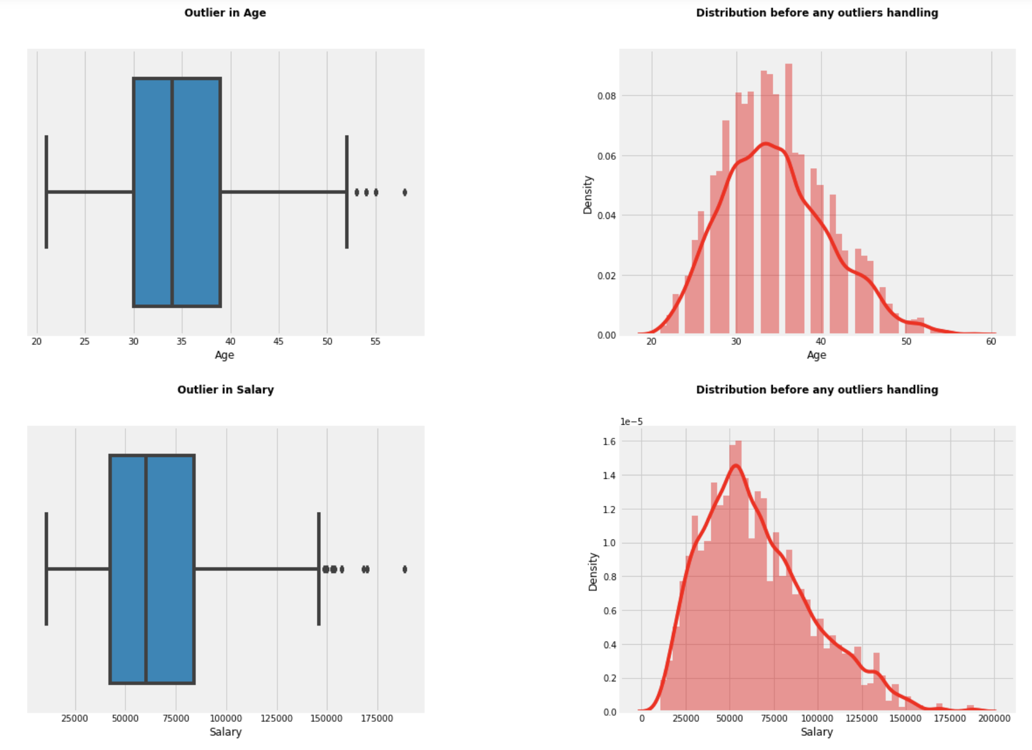
Business
Understanding
Data
Understanding
Data Preparation
Modeling
Evaluation
Deployment
Conclusion
Outlier Detection
Using BoxPlots for Numerical attributes:

Slide 35
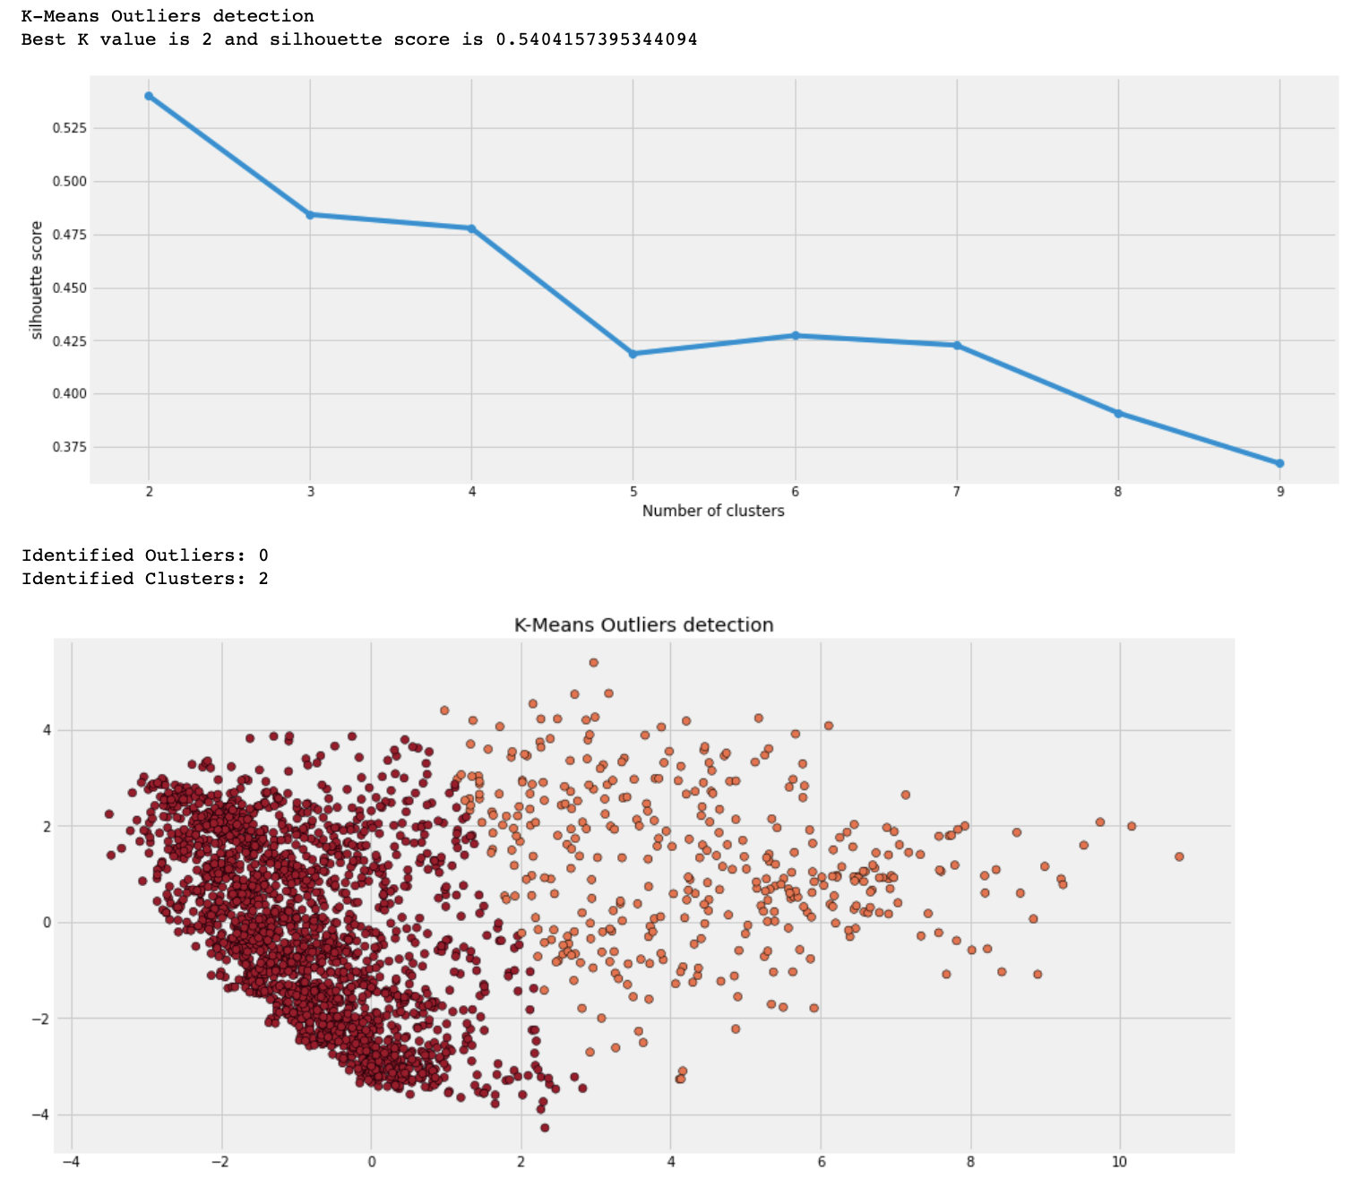
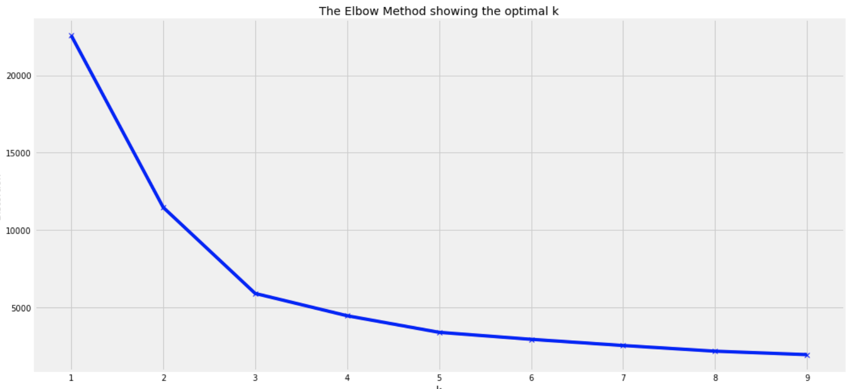
Business
Understanding
Data
Understanding
Data Preparation
Modeling
Evaluation
Deployment
Conclusion
Outlier Detection
K-Means Clustering
Best cluster =2 from Silhouette method
No. of cluster =3 from Elbow method
Inference: from K-means we could not find the outliers clearly also Silhouette score is quite low which indicates clustering is not good.
No outliers detected as K-means works on hard clustering

Slide 36
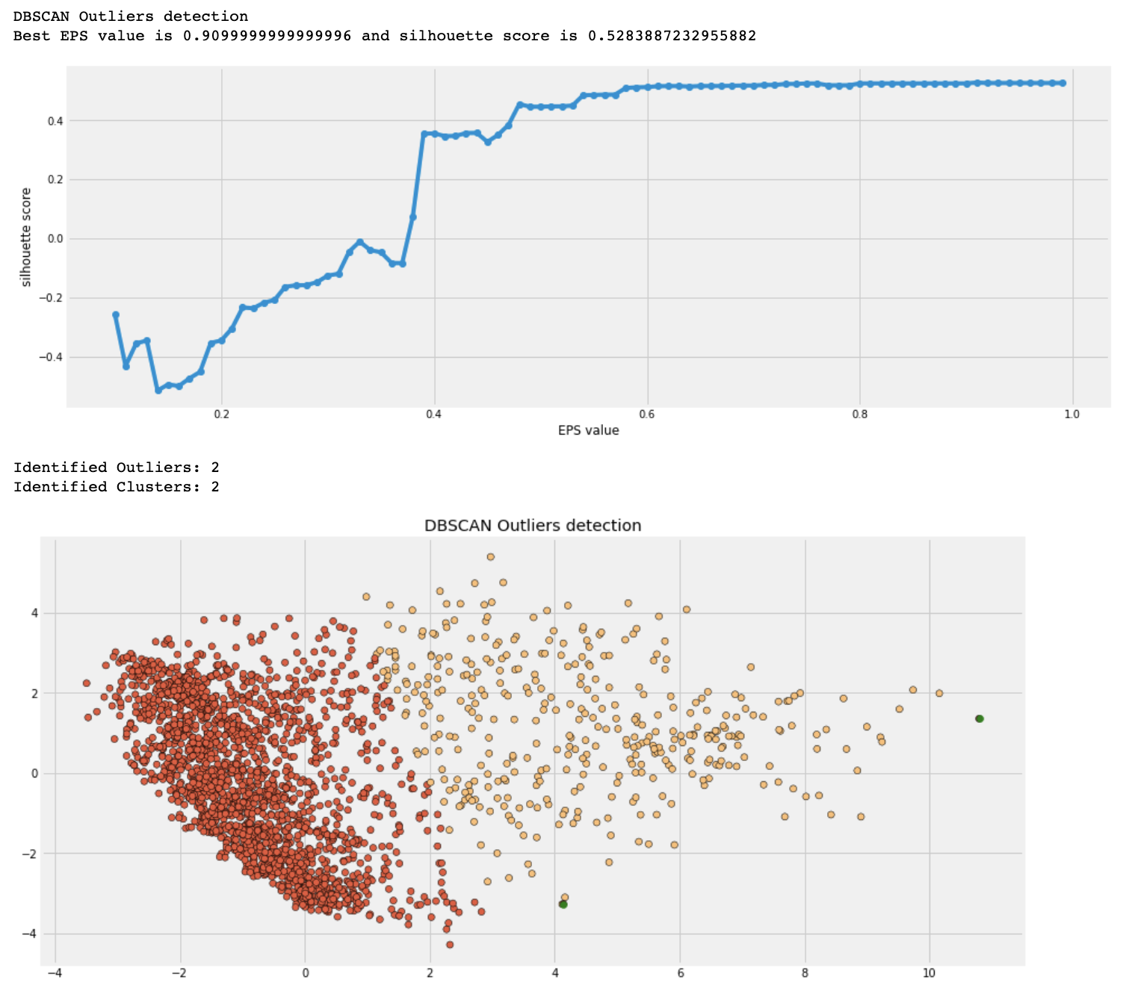
Business
Understanding
Data
Understanding
Data Preparation
Modeling
Evaluation
Deployment
Conclusion
Multi variate Outlier Detection
Using DB SCAN
Hyper parameter – EPS value detection
DB SCAN output
EPS=0.9
Min points= 5
Outliers
* Data was converted to 2D using PCA for visualization

Slide 37
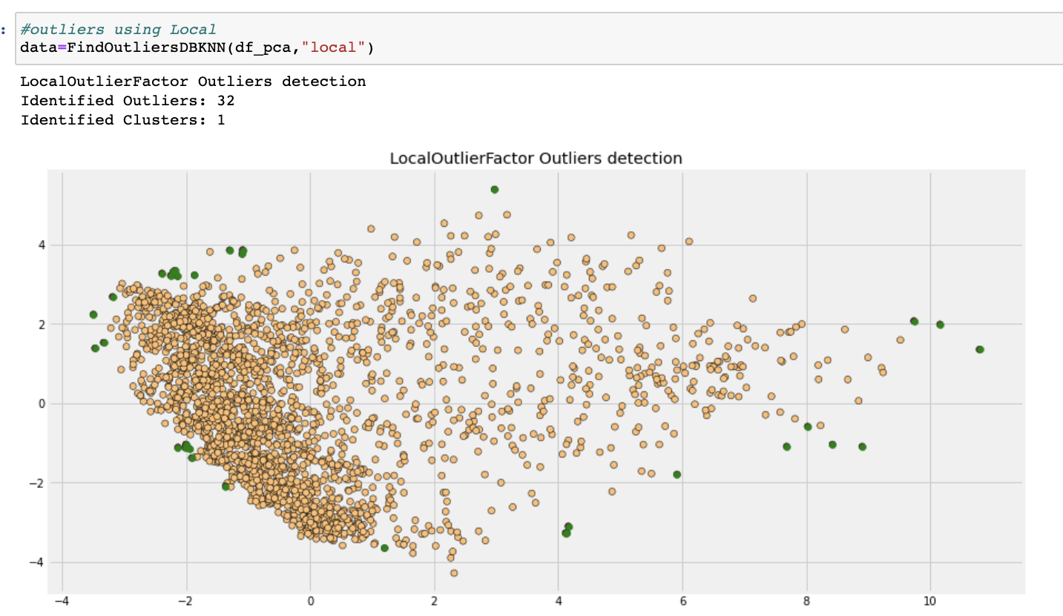
Business
Understanding
Data
Understanding
Data Preparation
Modeling
Evaluation
Deployment
Conclusion
Multi variate Outlier Detection
Using Local Outlier Factor
Inference:
32 Outliers detected
Clusters formed = 1
* Data was converted to 2D using PCA for visualization

Slide 38
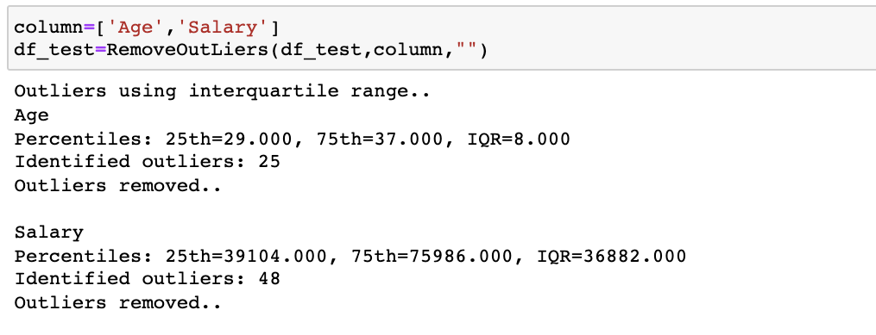
Business
Understanding
Data
Understanding
Data Preparation
Modeling
Evaluation
Deployment
Conclusion
Outlier Removal

Slide 39
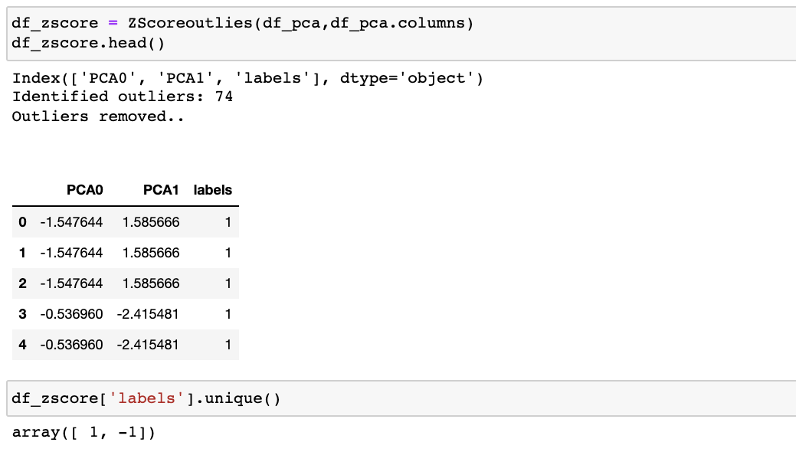
Business
Understanding
Data
Understanding
Data Preparation
Modeling
Evaluation
Deployment
Conclusion
Outlier Removal
Notes:
Vijay – till last

Slide 40
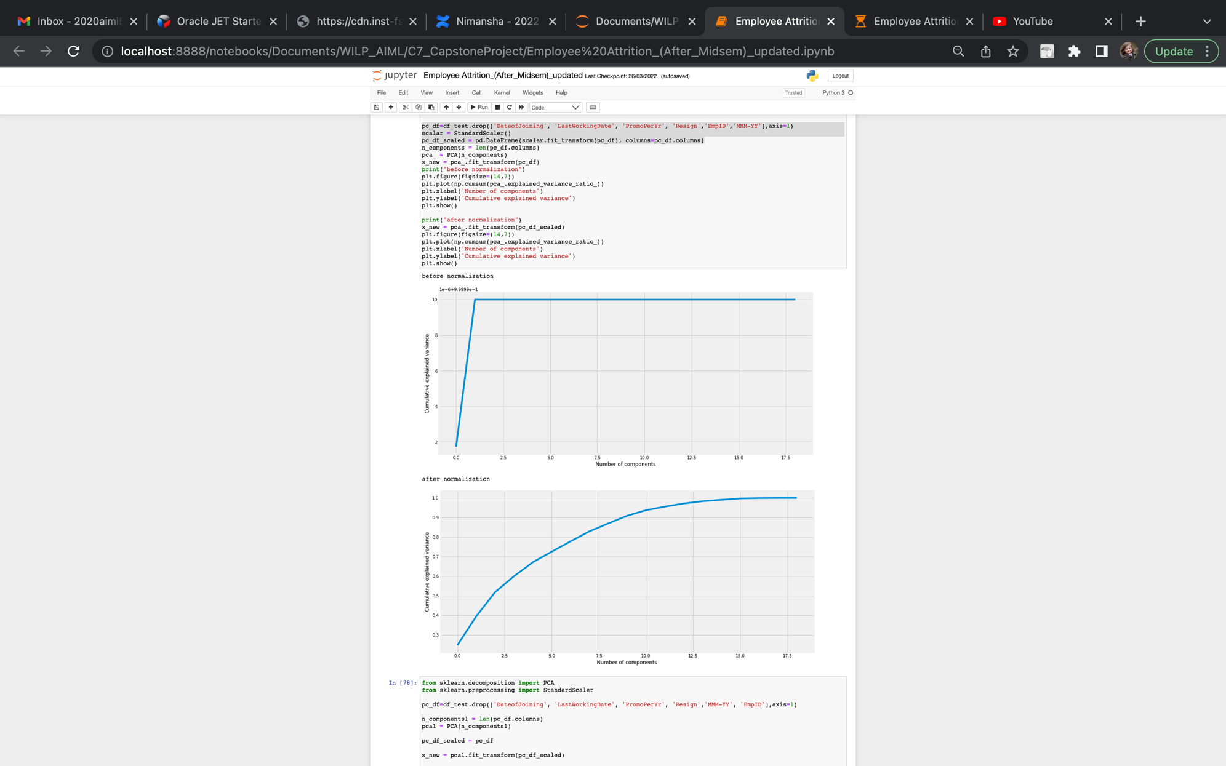
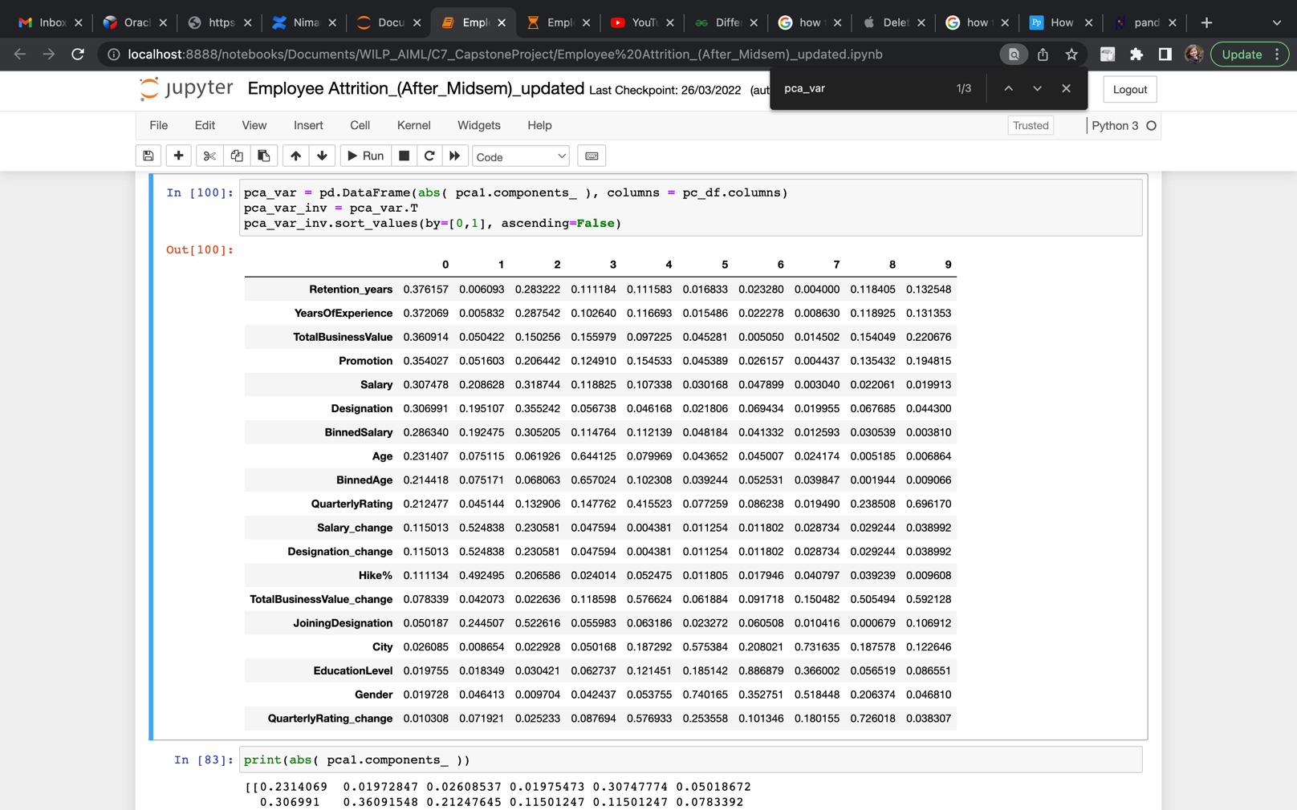
Business
Understanding
Data
Understanding
Data Preparation
Modeling
Evaluation
Deployment
Conclusion
PCA
95% of variance is preserved for 10 Principal Components
Contribution of each feature to the 10 Principal components is summarized in the adjacent table.
Notes:
Vijay – till last

Slide 41
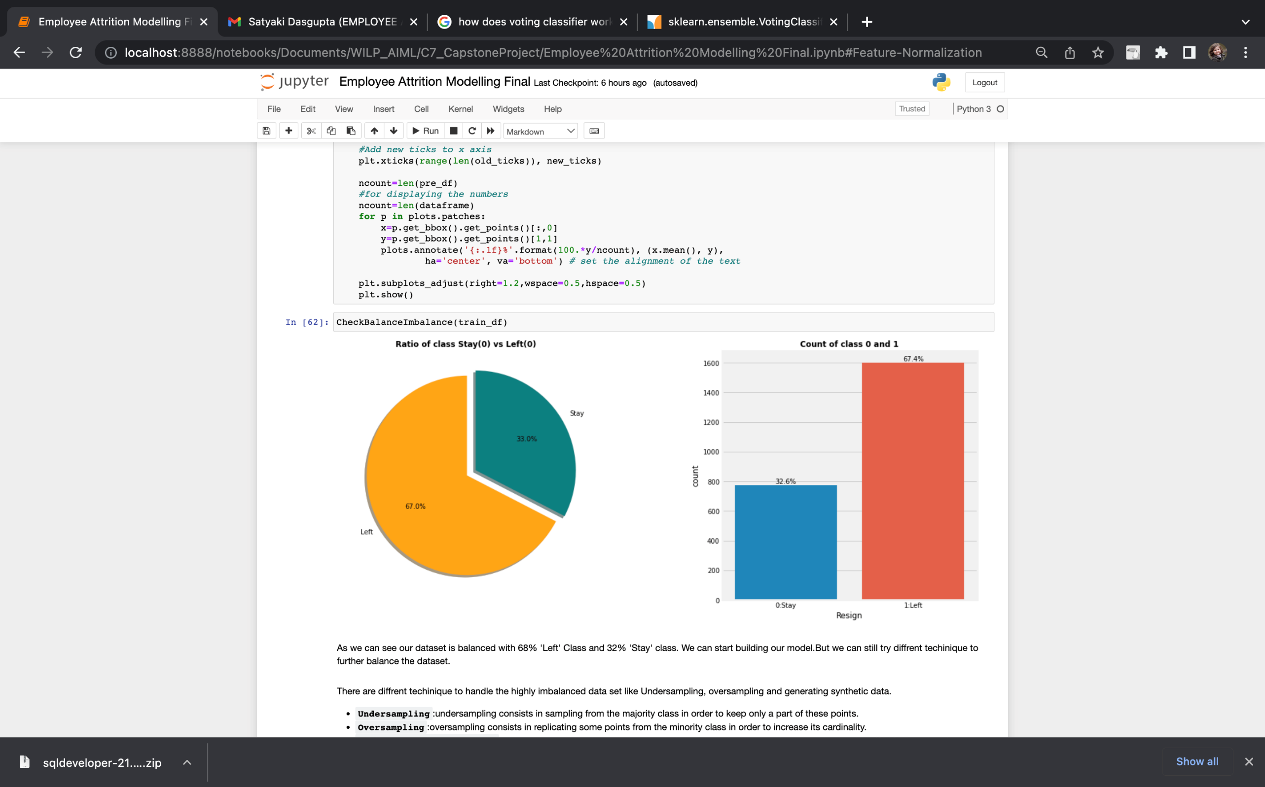

Business
Understanding
Data
Understanding
Data Preparation
Modeling
Evaluation
Deployment
Conclusion
Checking Data Imbalance
Undersampling
Notes:
Vijay – till last

Slide 42


Business
Understanding
Data
Understanding
Data Preparation
Modeling
Evaluation
Deployment
Conclusion
Feature Selection
Recursive Feature Elimination
=>RFE with Decision Tree on unbalanced data
=>RFE with Decision Tree on balanced data
Notes:
Vijay – till last

Slide 43

Business
Understanding
Data
Understanding
Data Preparation
Modeling
Evaluation
Deployment
Conclusion
Feature Selection
Recursive Feature Elimination with Cross Validation
=>Feature importance (inverse ranking) RFECV with Decision Tree
Notes:
Vijay – till last

Slide 44


Business
Understanding
Data
Understanding
Data Preparation
Modeling
Evaluation
Deployment
Conclusion
Feature Selection
SelectKBest for Feature Selection
Feature importance from SelectKBest using f_classif
Feature importance from SelectKBest using mutual_info_classif
Notes:
Vijay – till last

Slide 45

Business
Understanding
Data
Understanding
Data Preparation
Modeling
Evaluation
Deployment
Conclusion
Model Training
Notes:
Vijay – till last

Slide 46


Business
Understanding
Data
Understanding
Data Preparation
Modeling
Evaluation
Deployment
Conclusion
Model Training
Base models build over different datasets with default parameter summarized in table.
Notes:
Vijay – till last

Slide 47




Business
Understanding
Data
Understanding
Data Preparation
Modeling
Evaluation
Deployment
Conclusion
Accuracy comparison
Base model comparison based on cross validation score using accuracy
Notes:
Vijay – till last

Slide 48



Business
Understanding
Data
Understanding
Data Preparation
Modeling
Evaluation
Deployment
Conclusion
Logistic Regression using RSCV
Logistic Regression model using Randomized Search CV on Balanced Derived Dataset
Notes:
Vijay – till last

Slide 49



Business
Understanding
Data
Understanding
Data Preparation
Modeling
Evaluation
Deployment
Conclusion
Logistic Regression using RSCV
Logistic Regression model using Randomized Search CV on Balanced Binned Derived Dataset
Notes:
Vijay – till last

Slide 50



Business
Understanding
Data
Understanding
Data Preparation
Modeling
Evaluation
Deployment
Conclusion
Logistic Regression using RSCV
Logistic Regression model using Randomized Search CV on Stdscaled Balanced Binned Derived Dataset
Notes:
Vijay – till last

Slide 51



Business
Understanding
Data
Understanding
Data Preparation
Modeling
Evaluation
Deployment
Conclusion
Logistic Regression using RSCV
Logistic Regression model using Randomized Search CV on Minmaxscaled Balanced Binned Derived Dataset
Notes:
Vijay – till last

Slide 52


Business
Understanding
Data
Understanding
Data Preparation
Modeling
Evaluation
Deployment
Conclusion
Logistic Regression with RFECV
Logistic Regression model with RFECV on Balanced Derived Dataset
Notes:
Vijay – till last

Slide 53


Business
Understanding
Data
Understanding
Data Preparation
Modeling
Evaluation
Deployment
Conclusion
Logistic Regression with RFECV
Logistic Regression model with RFECV on Balanced Binned Derived Dataset
Notes:
Vijay – till last

Slide 54


Business
Understanding
Data
Understanding
Data Preparation
Modeling
Evaluation
Deployment
Conclusion
Logistic Regression with RFECV
Logistic Regression model with RFECV on Stdscaled Balanced Binned Derived Dataset
Notes:
Vijay – till last

Slide 55


Business
Understanding
Data
Understanding
Data Preparation
Modeling
Evaluation
Deployment
Conclusion
Logistic Regression with RFECV
Logistic Regression model with RFECV on Minmaxscaled Balanced Binned Derived Dataset
Notes:
Vijay – till last

Slide 56


Business
Understanding
Data
Understanding
Data Preparation
Modeling
Evaluation
Deployment
Conclusion
Decision Tree with RFECV
Decision Tree model with RFECV on Balanced Derived Dataset
Notes:
Vijay – till last

Slide 57


Business
Understanding
Data
Understanding
Data Preparation
Modeling
Evaluation
Deployment
Conclusion
Decision Tree with RFECV
Decision Tree model with RFECV on Balanced Binned Derived Dataset
Notes:
Vijay – till last

Slide 58


Business
Understanding
Data
Understanding
Data Preparation
Modeling
Evaluation
Deployment
Conclusion
Decision Tree with RFECV
Decision Tree model with RFECV on Stdscaled Balanced Binned Derived Dataset
Notes:
Vijay – till last

Slide 59


Business
Understanding
Data
Understanding
Data Preparation
Modeling
Evaluation
Deployment
Conclusion
Decision Tree with RFECV
Decision Tree model with RFECV on Minmaxscaled Balanced Binned Derived Dataset
Notes:
Vijay – till last

Slide 60



Business
Understanding
Data
Understanding
Data Preparation
Modeling
Evaluation
Deployment
Conclusion
KNeighbors Classifier
KNeighborsClassifier model on Balanced Derived Data
Notes:
Vijay – till last

Slide 61



Business
Understanding
Data
Understanding
Data Preparation
Modeling
Evaluation
Deployment
Conclusion
KNeighbors Classifier
KNeighborsClassifier model on Balanced Binned Derived Data
Notes:
Vijay – till last

Slide 62



Business
Understanding
Data
Understanding
Data Preparation
Modeling
Evaluation
Deployment
Conclusion
KNeighbors Classifier
KNeighborsClassifier model on Stdscaled Balanced Binned Derived Data
Notes:
Vijay – till last

Slide 63



Business
Understanding
Data
Understanding
Data Preparation
Modeling
Evaluation
Deployment
Conclusion
Bernoulli Naïve Bayes
BernoulliNB model on Balanced Derived Data
Notes:
Vijay – till last

Slide 64



Business
Understanding
Data
Understanding
Data Preparation
Modeling
Evaluation
Deployment
Conclusion
Bernoulli Naïve Bayes
BernoulliNB model on Balanced Binned Derived Data
Notes:
Vijay – till last

Slide 65



Business
Understanding
Data
Understanding
Data Preparation
Modeling
Evaluation
Deployment
Conclusion
Bernoulli Naïve Bayes
BernoulliNB model on Stdscaled Balanced Binned Derived Data
Notes:
Vijay – till last

Slide 66



Business
Understanding
Data
Understanding
Data Preparation
Modeling
Evaluation
Deployment
Conclusion
Bernoulli Naïve Bayes
BernoulliNB model on Minmaxscaled Balanced Binned Data
Notes:
Vijay – till last

Slide 67



Business
Understanding
Data
Understanding
Data Preparation
Modeling
Evaluation
Deployment
Conclusion
Gaussian Naïve Bayes
GaussianNB model on Balanced Derived Data
Notes:
Vijay – till last

Slide 68



Business
Understanding
Data
Understanding
Data Preparation
Modeling
Evaluation
Deployment
Conclusion
Gaussian Naïve Bayes
GaussianNB model on Balanced Binned Derived Data
Notes:
Vijay – till last

Slide 69



Business
Understanding
Data
Understanding
Data Preparation
Modeling
Evaluation
Deployment
Conclusion
Gaussian Naïve Bayes
GaussianNB model on Stdscaled Balanced Binned Derived Data
Notes:
Vijay – till last

Slide 70



Business
Understanding
Data
Understanding
Data Preparation
Modeling
Evaluation
Deployment
Conclusion
Gaussian Naïve Bayes
GaussiaNB model on Minmaxscale Balanced Binned Derived Data
Notes:
Vijay – till last

Slide 71



Business
Understanding
Data
Understanding
Data Preparation
Modeling
Evaluation
Deployment
Conclusion
Random Forest
Random Forest model on Balanced Derived Data
Notes:
Vijay – till last

Slide 72


Business
Understanding
Data
Understanding
Data Preparation
Modeling
Evaluation
Deployment
Conclusion
Random Forest with RFECV
Random Forest model on Balanced Derived Data
Notes:
Vijay – till last

Slide 73


Business
Understanding
Data
Understanding
Data Preparation
Modeling
Evaluation
Deployment
Conclusion
Random Forest with RFECV
Random Forest model on Balanced Binned Derived Data
Notes:
Vijay – till last

Slide 74


Business
Understanding
Data
Understanding
Data Preparation
Modeling
Evaluation
Deployment
Conclusion
Random Forest with RFECV
Random Forest model on Stdscaled Balanced Binned Derived Data
Notes:
Vijay – till last

Slide 75


Business
Understanding
Data
Understanding
Data Preparation
Modeling
Evaluation
Deployment
Conclusion
Random Forest with RFECV
Random Forest model on Minmaxscaled Balanced Binned Derived Data
Notes:
Vijay – till last

Slide 76


Business
Understanding
Data
Understanding
Data Preparation
Modeling
Evaluation
Deployment
Conclusion
Gradient Boosting with RFECV
GradientBoosting model with RFECV on Balanced Derived Data
Notes:
Vijay – till last

Slide 77


Business
Understanding
Data
Understanding
Data Preparation
Modeling
Evaluation
Deployment
Conclusion
Gradient Boosting with RFECV
GradientBoosting model with RFECV on Balanced Binned Derived Data
Notes:
Vijay – till last

Slide 78


Business
Understanding
Data
Understanding
Data Preparation
Modeling
Evaluation
Deployment
Conclusion
Gradient Boosting with RFECV
GradientBoosting model with RFECV on Stdscaled Balanced Binned Derived Data
Notes:
Vijay – till last

Slide 79


Business
Understanding
Data
Understanding
Data Preparation
Modeling
Evaluation
Deployment
Conclusion
Gradient Boosting with RFECV
GradientBoosting model with RFECV on Minmaxscaled Balanced Binned Derived Data
Notes:
Vijay – till last

Slide 80


Business
Understanding
Data
Understanding
Data Preparation
Modeling
Evaluation
Deployment
Conclusion
AdaBoost Classifier with RFECV
AdaBoost mode with RFECV on Balanced Derived Data
Notes:
Vijay – till last

Slide 81


Business
Understanding
Data
Understanding
Data Preparation
Modeling
Evaluation
Deployment
Conclusion
AdaBoost Classifier with RFECV
AdaBoost model with RFECV on Balanced Binned Derived Data
Notes:
Vijay – till last

Slide 82


Business
Understanding
Data
Understanding
Data Preparation
Modeling
Evaluation
Deployment
Conclusion
AdaBoost Classifier with RFECV
AdaBoost model with RFECV on Stdscaled Balanced Binned Derived Data
Notes:
Vijay – till last

Slide 83


Business
Understanding
Data
Understanding
Data Preparation
Modeling
Evaluation
Deployment
Conclusion
AdaBoost Classifier with RFECV
AdaBoost model with RFECV on Minmaxscaled Balanced Binned Derived Data
Notes:
Vijay – till last

Slide 84



Business
Understanding
Data
Understanding
Data Preparation
Modeling
Evaluation
Deployment
Conclusion
Voting Classifier with RFECV
Voting Classifier model on Balanced Derived Data
Notes:
Vijay – till last

Slide 85



Business
Understanding
Data
Understanding
Data Preparation
Modeling
Evaluation
Deployment
Conclusion
Voting Classifier with RFECV
Voting Classifier model on Balanced Binned Derived Data
Notes:
Vijay – till last

Slide 86



Business
Understanding
Data
Understanding
Data Preparation
Modeling
Evaluation
Deployment
Conclusion
Voting Classifier with RFECV
Voting Classifier model on Stdscaled Balanced Binned Derived Data
Notes:
Vijay – till last

Slide 87



Business
Understanding
Data
Understanding
Data Preparation
Modeling
Evaluation
Deployment
Conclusion
Voting Classifier with RFECV
Voting Classifier model on Minmaxscaled Balanced Binned Derived Data
Notes:
Vijay – till last

Slide 88

Business
Understanding
Data
Understanding
Data Preparation
Modeling
Evaluation
Deployment
Conclusion
Modelling Summary
Models using best parameters from Randomized Search CV with Test Accuracy greater than 0.8
Notes:
Vijay – till last

Slide 89

Business
Understanding
Data
Understanding
Data Preparation
Modeling
Evaluation
Deployment
Conclusion
Modelling Summary
Models using best parameters from Randomized Search CV with Test Accuracy lesser than 0.8
Notes:
Vijay – till last

Slide 90

Business
Understanding
Data
Understanding
Data Preparation
Modeling
Evaluation
Deployment
Conclusion
Modelling Summary
Models with RFECV with Test Accuracy greater than or equal to 0.8
Notes:
Vijay – till last

Slide 91

Business
Understanding
Data
Understanding
Data Preparation
Modeling
Evaluation
Deployment
Conclusion
Modelling Summary
Models with RFECV with Test Accuracy greater than or equal to 0.8
Notes:
Vijay – till last

Slide 92


Business
Understanding
Data
Understanding
Data Preparation
Modeling
Evaluation
Deployment
Conclusion
Modelling Summary
Comparing all models built:
Models with Accuracy >=0.8
Models with Accuracy <0.8
Notes:
Vijay – till last

Slide 93

Business
Understanding
Data
Understanding
Data Preparation
Modeling
Evaluation
Deployment
Conclusion
Deployment
Home Page: Deployment
Notes:
Vijay – till last

Slide 94


Business
Understanding
Data
Understanding
Data Preparation
Modeling
Evaluation
Deployment
Conclusion
Deployment
Deployment: Batch Prediction vs Single Prediction
Notes:
Vijay – till last

Slide 95
Business
Understanding
Data
Understanding
Data Preparation
Modeling
Evaluation
Deployment
Conclusion
Conclusion
With the given data set, 7 attribute below tends to influence on employee attrition ( filter method)
Quarterly Rating 2. Total business value 3. Change in Total business value 4. Designation 5. Rentention_years 6. Salary 7. City
A total of 60 models have been built using 9 different algorithm and trained on 4 different datasets. Out of which 36 models were built using the best parameter concluded from the Randomized Search CV applied on the 9 algorithms and 24 models were built using the RFECV technique on the models.
Data prove Quarterly Rating (is having highest information gain) is most influencing parameter & has strong relation with employee retention.
Out of all the models Gradient boosting Classifier gives the maximum test accuracy of 0.88 and the train accuracy of 0.93, precision of {0: 0.89, 1: 0.88} and recall of {0: 0.81, 1:0.93}
Further it was validated with 30 new records and model was able to predict correctly for 29 out of 30 employees.
We recommend this model for the deployment and can be used to predict for a given employee if he is likely to leave or not. This can help HR team to strategize the hiring or retention plan for better employee retention.
Since the given data spans over 2 years of reporting only. It is recommended to acquire data that covers records from larger duration of reporting for model building to achieve best results.
Recommendation
84% of the employees are below 40 years of age with mean age at 34 years. Out of given dataset for 2381 employees, 2008 employees have joined the organisation only from 2015 to 2017 (84%) => Less attrition is seen with higher age group. Hence it is recommended to have a retention scheme which can reduce the attrition rate.
Maximum employees (73.24%) are rated as ‘1’ (lowest performance rating) which can be related to huge attrition=> Organisation has to relook in the guideline for quarterly rating ‘1’ as this tends to have maximum impact. Example move from quarterly rating to Half yearly or Annual rating.
99% (2369 out of 2381) of the employees have no change in salary or promotion during 2016-2017. => Organisation should also look in to other monetary benefit like Bonus or minimum increment for average to good performers.
As the given dataset doesn’t have attribute covering the primary reason for employee leaving the organisation, It is recommended to introduce formal exit interview process to capture more details on this part.
Notes:
Vijay – till last

Slide 96
Employee Attrition Prediction
THANK YOU
Presented by Group 05:
K RAMAKRISHNAN
VIJAY KUMAR
KIRTI RANI
NIMANSHA MALIK
ABHISHEK SHUKLA

